Slide 1


DARSHAN BENNUR
August 16,2022

Slide 2

Outline
EXECUTIVE SUMMARY
INTRODUCTION
METHODOLOGY
RESULTS
CONCLUSION
APPENDIX

Slide 3
Executive Summary
Summary of methodologies
Data Collection through API
Data Collection with Web Scraping
Data Wrangling
Exploratory Data Analysis with SQL
Exploratory Data Analysis with Data Visualization
Interactive Visual Analytics with Folium
Machine Learning Prediction
Summary of all results
Exploratory Data Analysis result
Interactive analytics in screenshots
Predictive Analytics result

Slide 4
Introduction
Project background and context
SpaceX advertises Falcon 9 rocket launches on its website with a cost of 62 million dollars; other providers cost upward of 165 million dollars each, much of the savings is because Space X can reuse the first stage. Therefore, if we can determine if the first stage will land, we can determine the cost of a launch. This information can be used if an alternate company wants to bid against spaceX for a rocket launch. This goal of the project is to create a machine learning pipeline to predict if the first stage will land successfully.
Problems you want to find answers
What factors determine if the rocket will land successfully?
What is the effect of each relationship of rockets will land successfully?
What are the conditions needs to be in place to ensure a successful landing program.

Slide 5

Section 1

Slide 6
Methodology
Executive Summary
Data collection methodology - Data was collected using SpaceX API and web scraping from Wikipedia.
Perform data wrangling - - One-hot encoding was applied to categorical features
Perform exploratory data analysis (EDA) using visualization and SQL
Perform interactive visual analytics using Folium and Plotly Dash
Perform predictive analysis using classification model - How to build, tune, evaluate classification models

Slide 7
Data Collection
The data was collected using various methods
Data collection was done using get request to the SpaceX API.
Next, we decoded the response content as a Json using .json() function call and turn it into a pandas dataframe using .json_normalize().
We then cleaned the data, checked for missing values and fill in missing values where necessary.
In addition, we performed web scraping from Wikipedia for Falcon 9 launch records with BeautifulSoup.
The objective was to extract the launch records as HTML table, parse the table and convert it to a pandas dataframe for future analysis.

Slide 8
Data Collection – SpaceX API
Getting Response from API
2. Converting response to a .json file
3. Apply Custom functions to clean data
GitHub URL Link:
https://github.com/darshanbennur9/SpaceX_Capstone_Project/blob/e249f78c50933a3118a77e42d3a345b6617fb1e3/jupyter-labs-spacex-data-collection-api_DB.ipynb
4. Assign list to dictionary then dataframe
5. Filter dataframe and export as .csv file

Slide 9
Data Collection - Scraping
Github URL Link:
https://github.com/darshanbennur9/SpaceX_Capstone_Project/blob/e249f78c50933a3118a77e42d3a345b6617fb1e3/jupyter-labs-webscraping_DB.ipynb
1
.Getting
Response
from
2.
8.
HTML
Creating
Datafram
Beautiful
e to .CSV
Soup
Object
7.
Converti
3. Finding
ng
tables
dictionar
y to
datafram
e
6.
4.
Appendin
Getting
g data to
column
•
keys
5.
names
Creation
of
dictionar
y

Slide 10
Calculate the
Calculate the
How data were
number of launches
number and
processed.
at each site
occurrence of each
orbit
DATA
Calculate the
number and
Create a landing
Export dataset as
WRANGLING
occurrence of
outcome label from
.CSV
mission outcome
Outcome column
per orbit type
Work out success
Add the GitHub
rate for every
URL
landing in dataset
GitHub URL Link:
https://github.com/darshanbennur9/SpaceX_Capstone_Project/blob/e249f78c50933a3118a77e42d3a345b6617fb1e3/labs-jupyter-spacex-Data%20wrangling_DB.ipynb
10

Slide 11
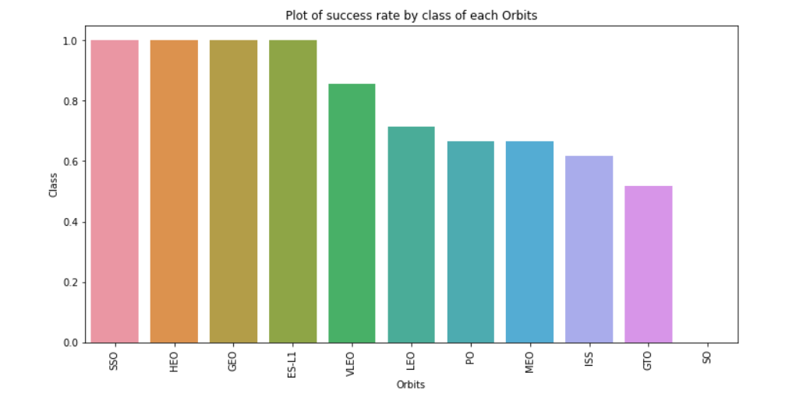
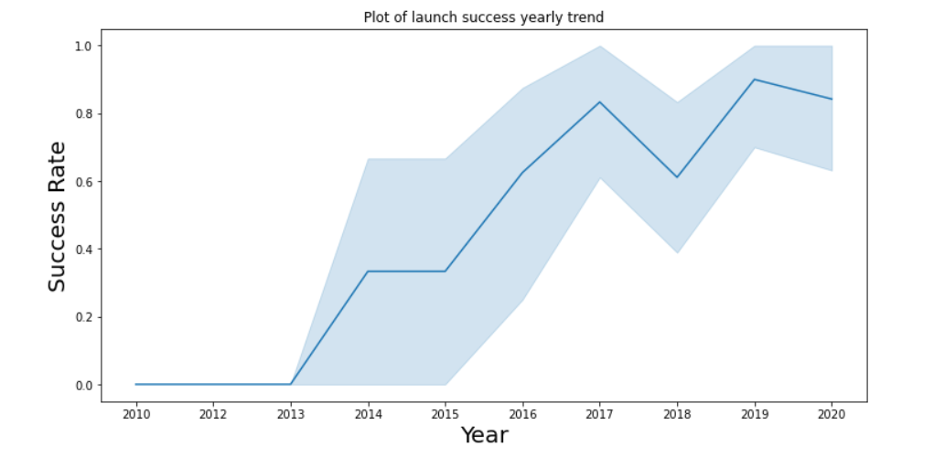
EDA with Data Visualization
We explored the data by visualizing the relationship between flight number and launch Site, payload and launch site, success rate of each orbit type, flight number and orbit type, the launch success yearly trend.
GitHub URL Link:
https://github.com/darshanbennur9/SpaceX_Capstone_Project/blob/e249f78c50933a3118a77e42d3a345b6617fb1e3/jupyter-labs-eda-dataviz_DB.ipynb

Slide 12
SUMMARY OF THE SQL QUERIES PERFORMED
The names of unique launch sites in the space mission.
The total payload mass carried by boosters launched by NASA (CRS)
The average payload mass carried by booster version F9 v1.1
The total number of successful and failure mission outcomes
The failed landing outcomes in drone ship, their booster version and launch site names.
EDA WITH
VISUALIZATION
GitHub URL Link:
https://github.com/darshanbennur9/SpaceX_Capstone_Project/blob/e249f78c50933a3118a77e42d3a345b6617fb1e3/jupyter-labs-eda-sql-coursera_sqllite_DB.ipynb

Slide 13
Build an Interactive Map with Folium
We marked all launch sites, and added map objects such as markers, circles, lines to mark the success or failure of launches for each site on the folium map.
We assigned the feature launch outcomes (failure or success) to class 0 and 1.i.e., 0 for failure, and 1 for success.
Using the color-labeled marker clusters, we identified which launch sites have relatively high success rate.
We calculated the distances between a launch site to its proximities. We answered some question for instance:
Are launch sites near railways, highways and coastlines.
Do launch sites keep certain distance away from cities.
GitHub URL Link:
https://github.com/darshanbennur9/SpaceX_Capstone_Project/blob/e249f78c50933a3118a77e42d3a345b6617fb1e3/lab_jupyter_launch_site_location_DB.ipynb

Slide 14
Build a Dashboard with Plotly Dash
We built an interactive dashboard with Plotly dash
We plotted pie charts showing the total launches by a certain sites
We plotted scatter graph showing the relationship with Outcome and Payload Mass (Kg) for the different booster version.
GitHub URL Link:
https://github.com/darshanbennur9/SpaceX_Capstone_Project/blob/41e7b34bdfe3985bd91f64551daa9dcf4f6ae62a/lab_jupyter_launch_site_location_DB.ipynb

Slide 15
Predictive Analysis (Classification)
We loaded the data using numpy and pandas, transformed the data, split our data into training and testing.
We built different machine learning models and tune different hyperparameters using GridSearchCV.
We used accuracy as the metric for our model, improved the model using feature engineering and algorithm tuning.
We found the best performing classification model.
GitHub URL Link:
https://github.com/darshanbennur9/SpaceX_Capstone_Project/blob/e249f78c50933a3118a77e42d3a345b6617fb1e3/SpaceX_Machine%20Learning%20Prediction_Part_5_DB.ipynb

Slide 16
Results
Exploratory data analysis results
Interactive analytics demo in screenshots
Predictive analysis results

Slide 17


Slide 18
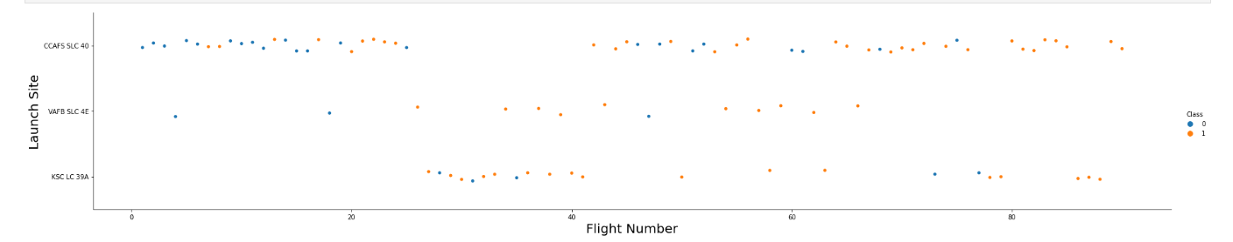
Flight Number vs. Launch Site
From the plot, we found that the larger the flight amount at a launch site, the higher the success rate at a launch site.

Slide 19
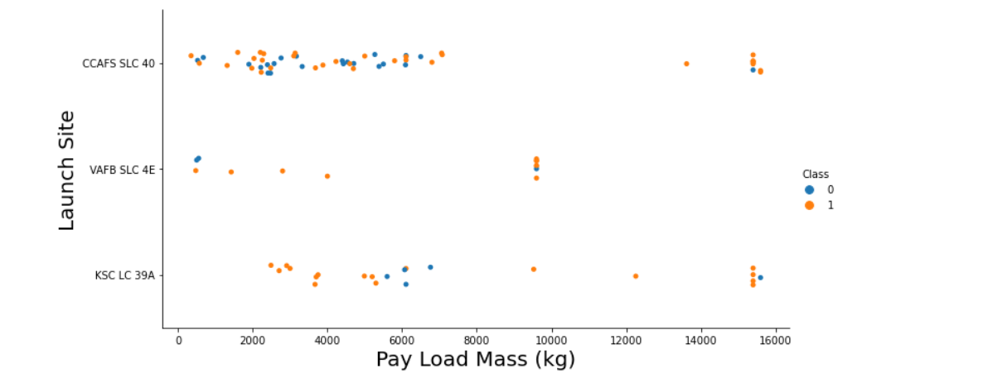

PAYLOAD vs. Launch Site

Slide 20
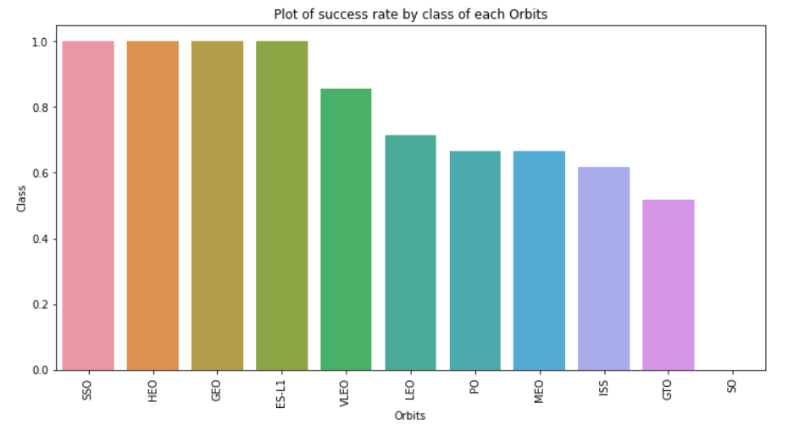
Success Rate vs. Orbit
From the plot, we can see that ES-L1, GEO, HEO, SSO, VLEO had the most success rate.

Slide 21
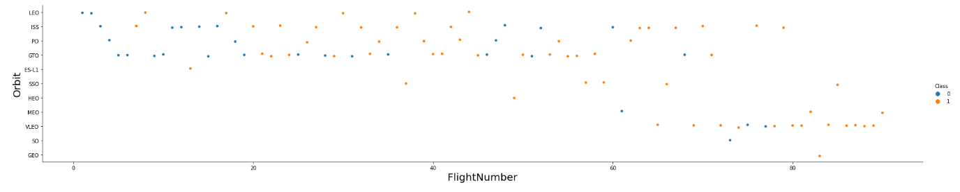
Flight Number vs. Orbit Type
The plot below shows the Flight Number vs. Orbit type. We observe that in the LEO orbit, success is related to the number of flights whereas in the GTO orbit, there is no relationship between flight number and the orbit.

Slide 22
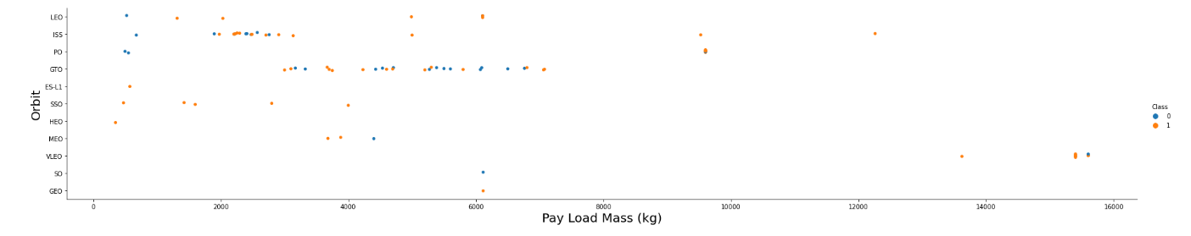
Payload vs. Orbit Type
We can observe that with heavy payloads, the successful landing are more for PO, LEO and ISS orbits.

Slide 23
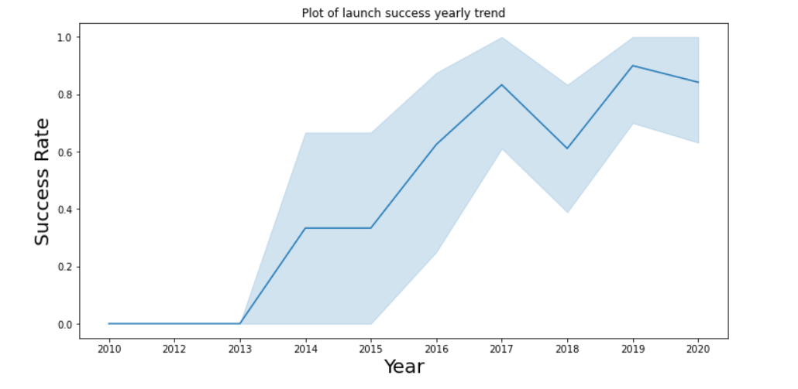
Launch Success Yearly Trend
From the plot, we can observe that success rate since 2013 kept on increasing till 2020.

Slide 24
EDA WITH SQL

Slide 25
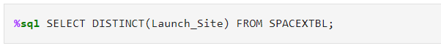
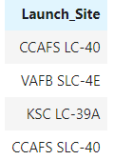
ALL Launch Site Names
SQL Query
We used the keyword DISTINCT to show only unique launch sites from the SpaceX data.

Slide 26
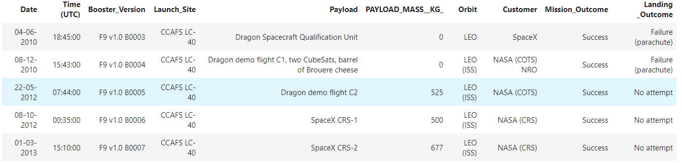
Launch Site Names Begin with 'CCA'
SQL Query
SQL query to display 5 records where launch sites begin with `CCA`

Slide 27
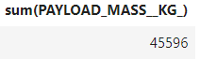
Total Payload Mass
SQL Query
Using SQL Query calculated the total payload carried by boosters from NASA as 45596

Slide 28
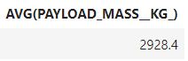
Average Payload Mass by F9 v1.1
SQL Query
Using SQL Query calculated the average payload mass carried by booster version F9 v1.1 as 2928.4

Slide 29
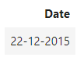
First Successful Ground Landing Date
SQL Query
Using SQL Query calculated the dates of the first successful landing outcome on ground pad was 22nd December 2015.

Slide 30
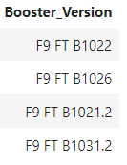
Successful Drone Ship Landing with Payload mass between 4000 and 6000
SQL Query
Using SQL Query found out the booster version which have successfully landed on drone ship with payload mass between 4000 and 6000.

Slide 31
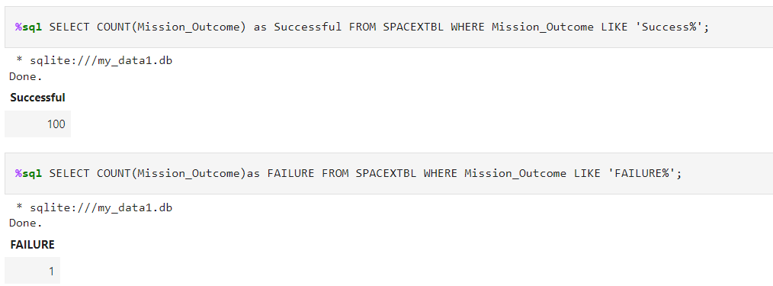
Total Number of Successful and Failure Mission Outcomes
SQL Query
Using SQL Query calculated the total number of successful mission outcome as 100 and failure outcome as 1.

Slide 32
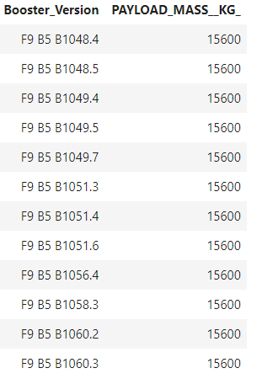
Boosters Carried Maximum Payload
SQL Query
Using SQL Query found the booster that have carried the maximum payload.

Slide 33
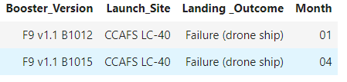
2015 Launch Records
SQL Query
Using SQL Query found the month, failure landing outcomes in drone ship, booster versions, launch_site for the year 2015.

Slide 34
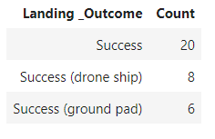
Rank Landing Outcomes Between 04-06-2010 and 20-03-2017
SQL Query
Using SQL Query found the total successful landing outcomes between 04-06-2010 and 20-03-2017

Slide 35


Slide 36
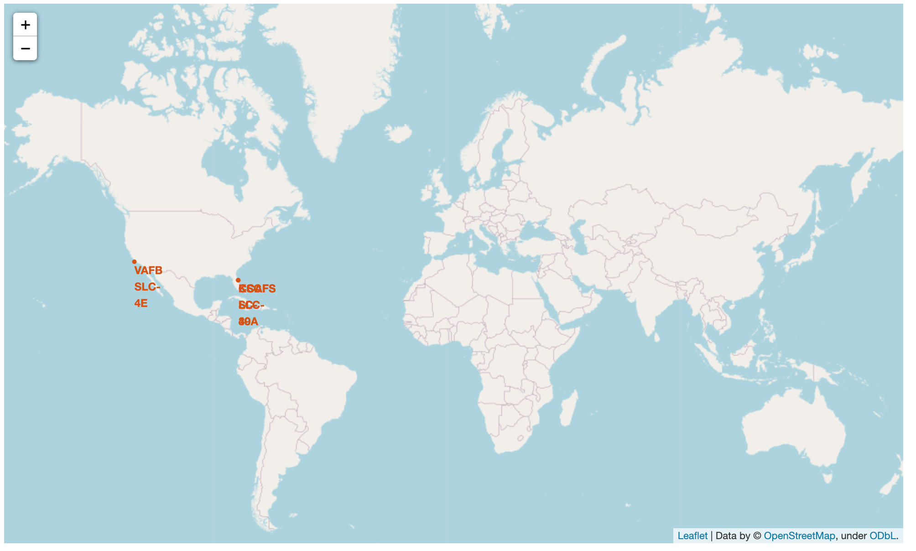
All launch sites global map markers
SpaceX launch sites are in United States of America coasts. California and Florida

Slide 37
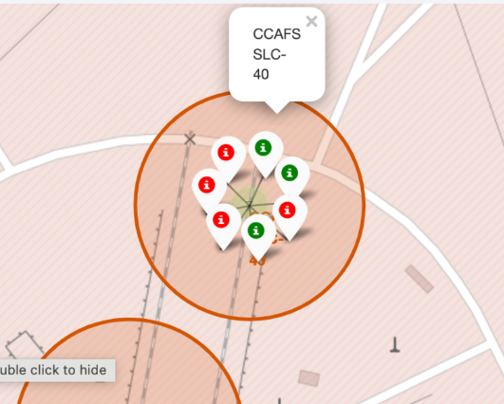
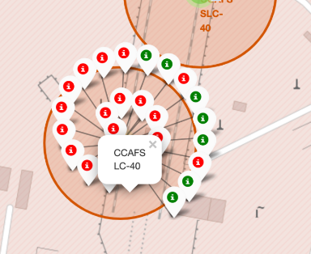
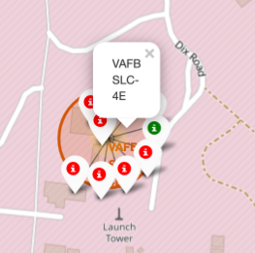
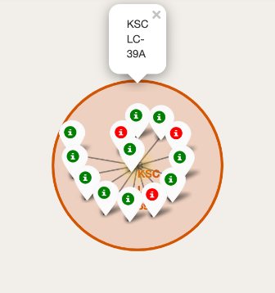
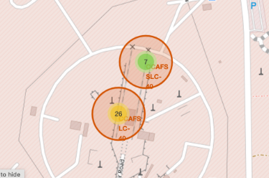
Markers showing launch sites with color labels
Florida Launch Sites
California Launch Sites
Green - Successful Launch
Red - Failure

Slide 38
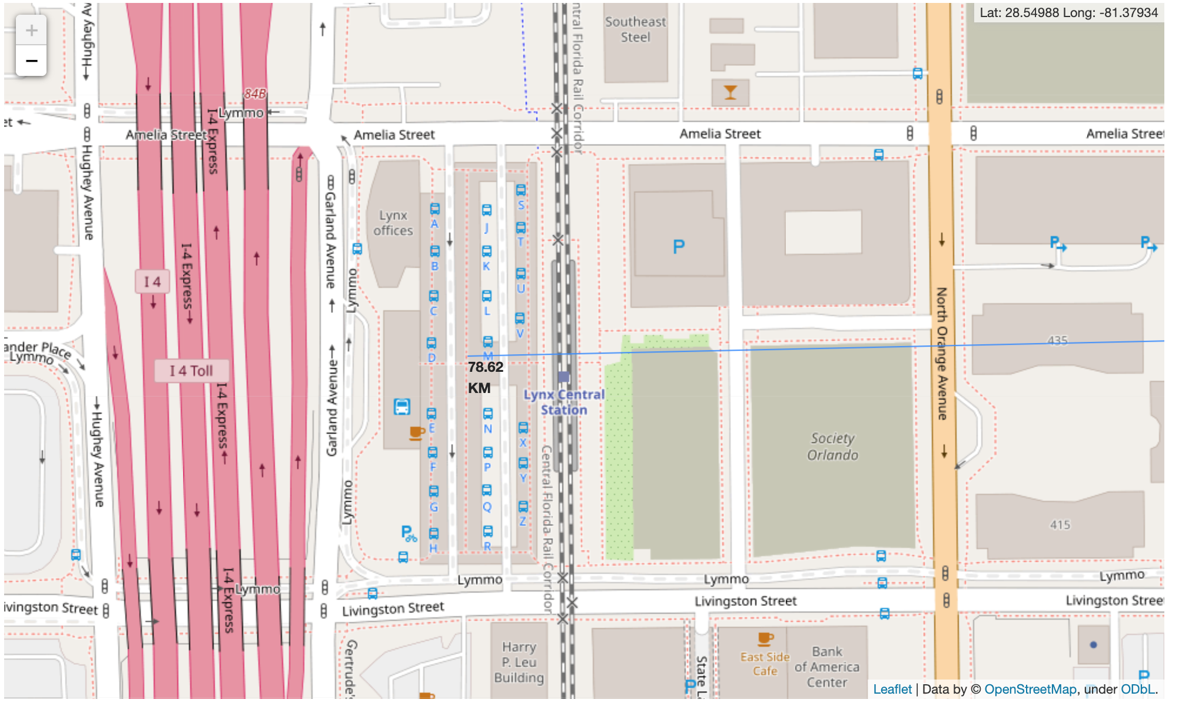
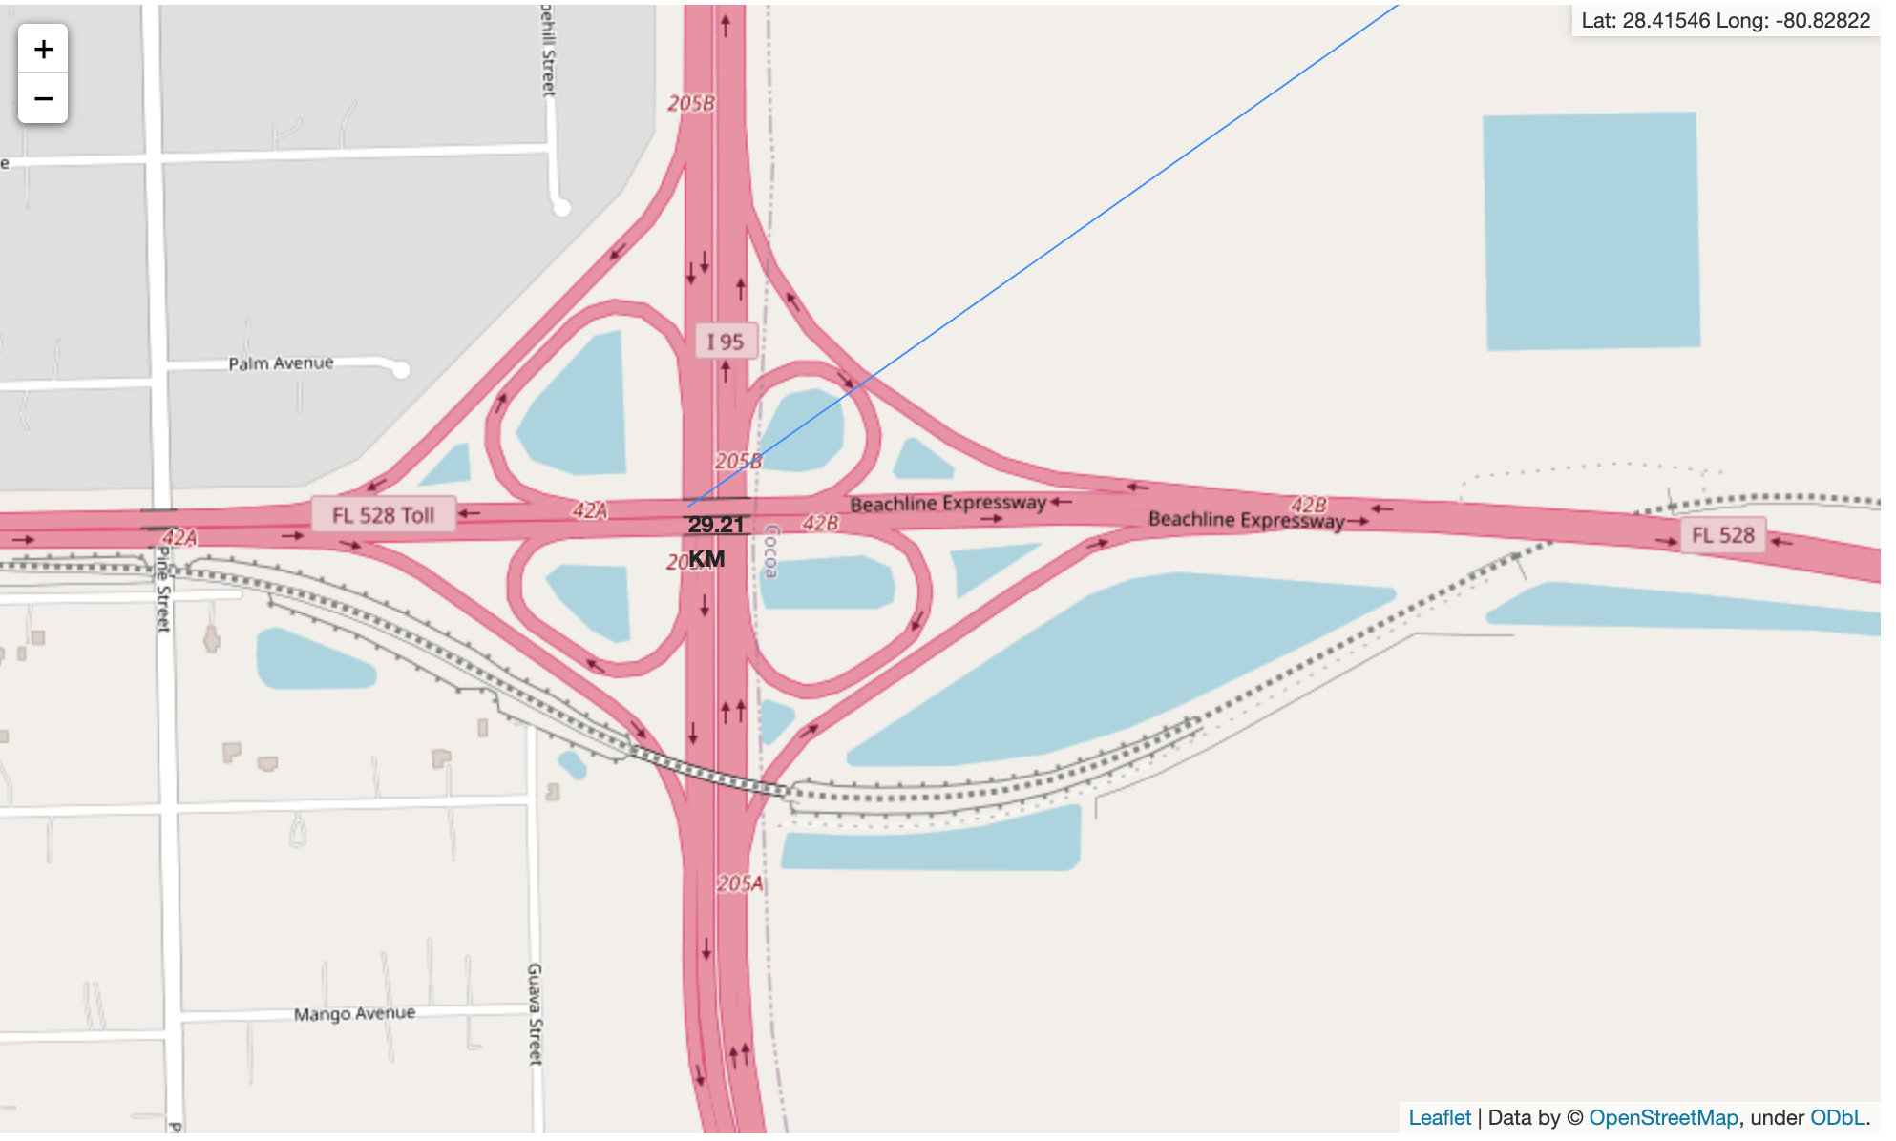
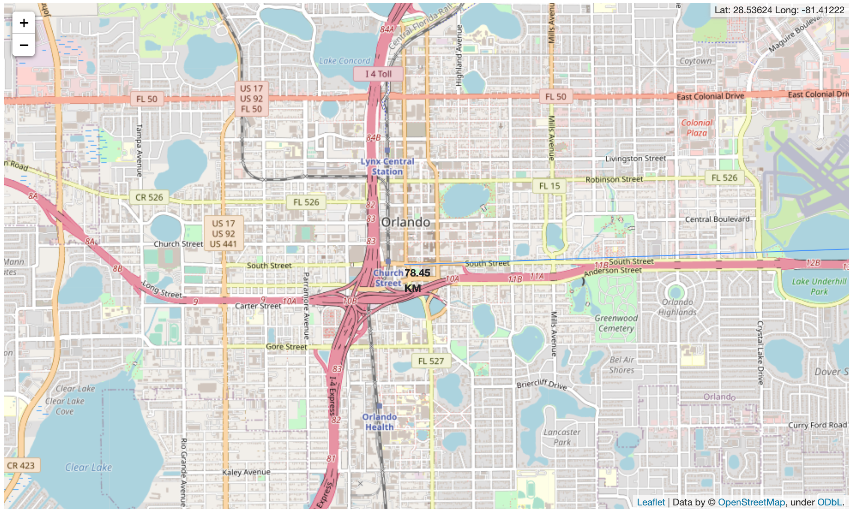
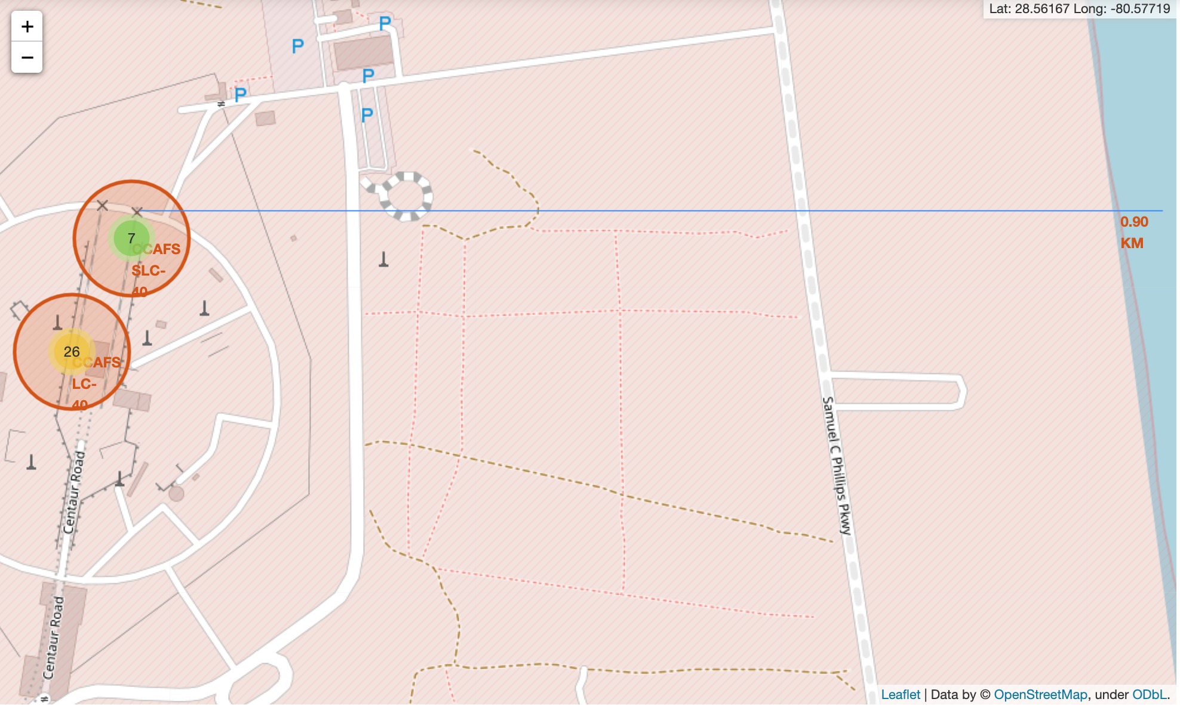
Launch Site distance to landmarks
Distance to Railways
Distance to Highway
Are launch sites in close proximity to railways? - No
Are launch sites in close proximity to highways? - No
Are launch sites in close proximity to coastline? - Yes
Do launch sites keep certain distance away from cities? - Yes
Distance to City
Distance to Coast

Slide 39


Slide 40
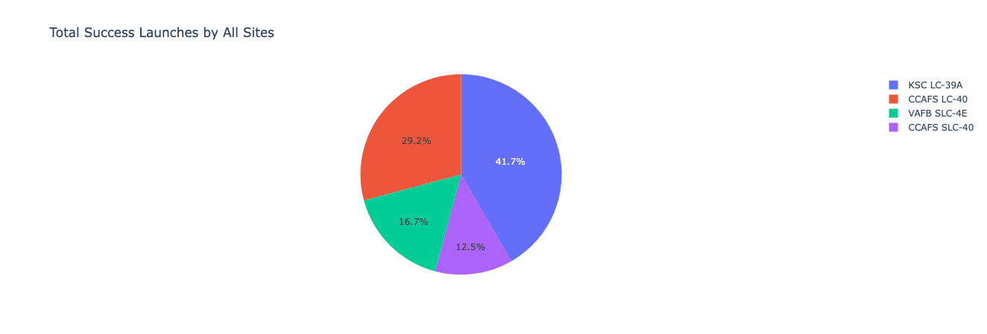
Pie chart showing the success percentage achieved by each launch site
From the pie chart we can observe that KSC LC - 39 A has the most successful launch from all the sites.

Slide 41
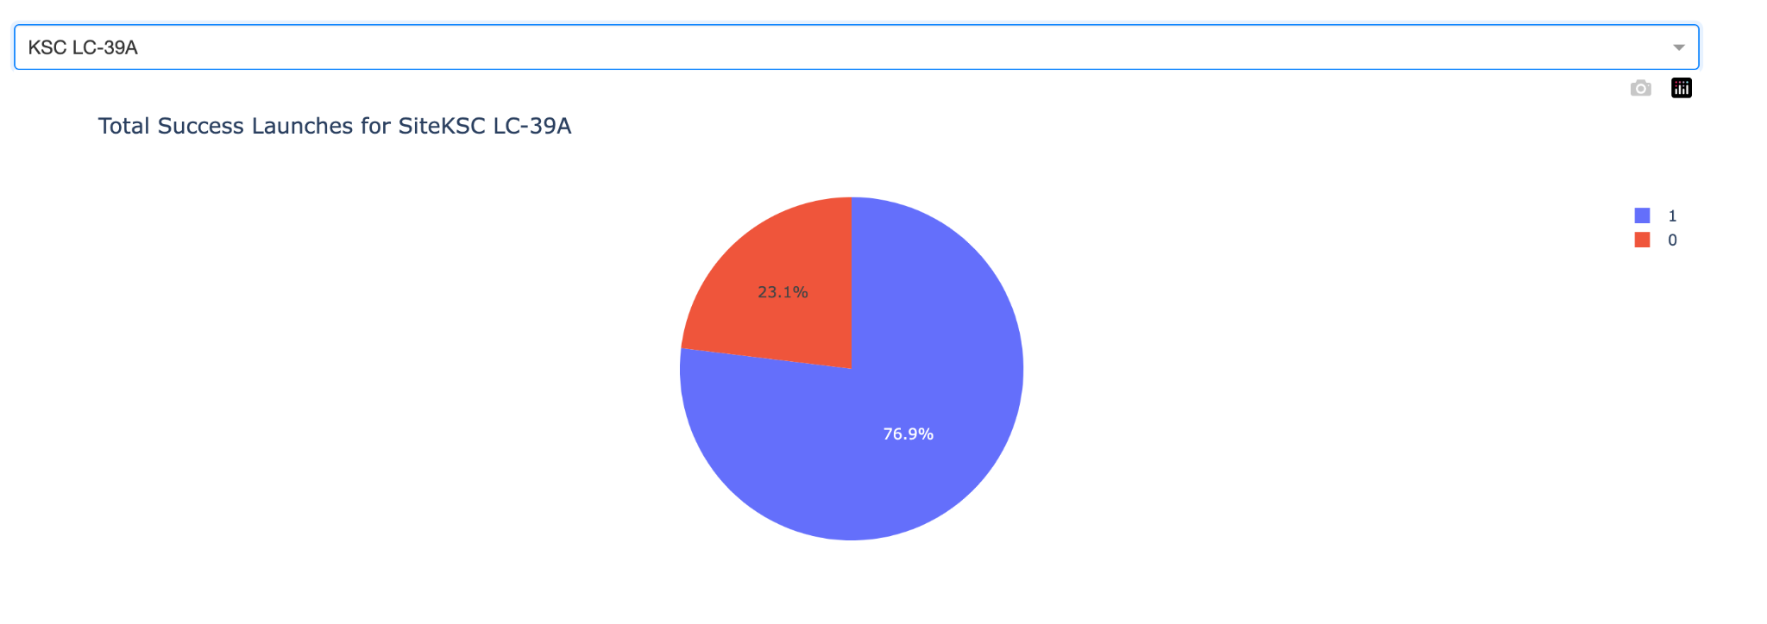
Pie chart showing the Launch site with the highest launch success ratio
From the pie chart we can observe that KSC LC - 39 A achieved 76.9 % success rate.

Slide 42
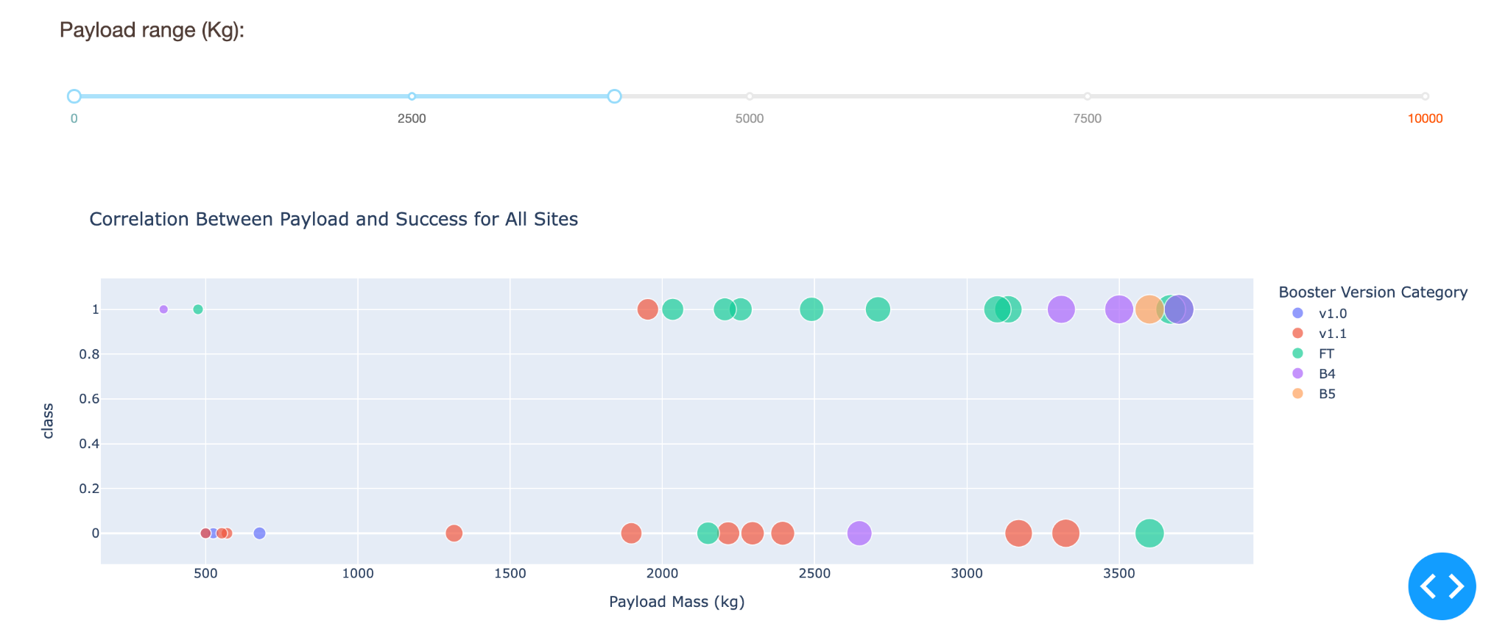
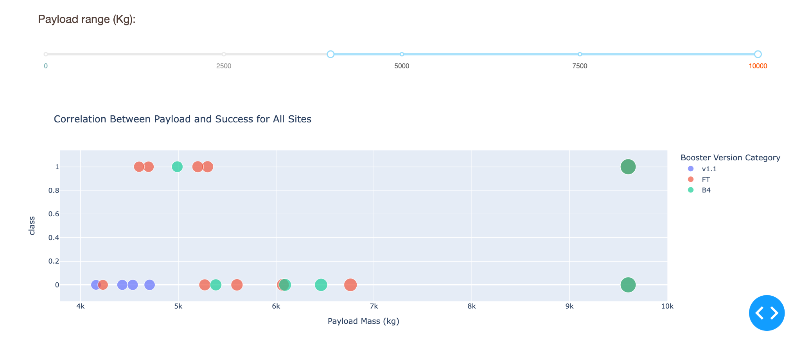
Scatter plot of Payload vs Launch Outcome for all sites, with different payload selected in the range slider
Low weighted payload 0kg – 4000kg
Heigh weighted payload 4000kg – 10000kg
From the graph we can observe that success rate is more for low payloads than higher payloads.

Slide 43


Slide 44
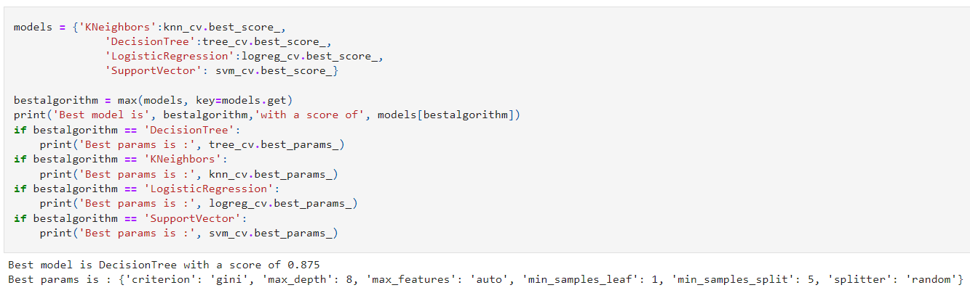
Classification Accuracy
`Algorithm | Accuracy | Accuracy on Test Data
Logistic Regression | 0.8464 | 0.8333
SVM | 0.8482 | 0.833
KN | 0.8482 | 0.833
Decision Tree | 0.875 | 0.833
The decision tree classifier is the model with the highest classification accuracy

Slide 45
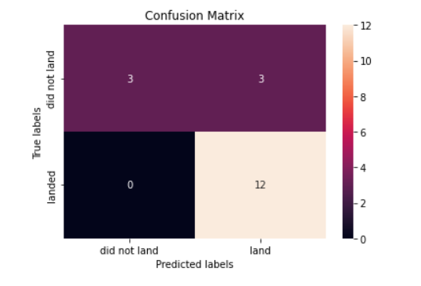
Confusion Matrix
All models used have the same confusion matrix.

Slide 46
Conclusions
We can conclude that:
The Decision tree classifier is the best machine learning algorithm for this task.
Launch success rate started to increase in 2013 till 2020.
The larger the flight amount at a launch site, the greater the success rate at a launch site.
Orbits ES-L1, GEO, HEO, SSO, VLEO had the most success rate.
KSC LC-39A had the most successful launches of any sites.

Slide 47


